Slide 1




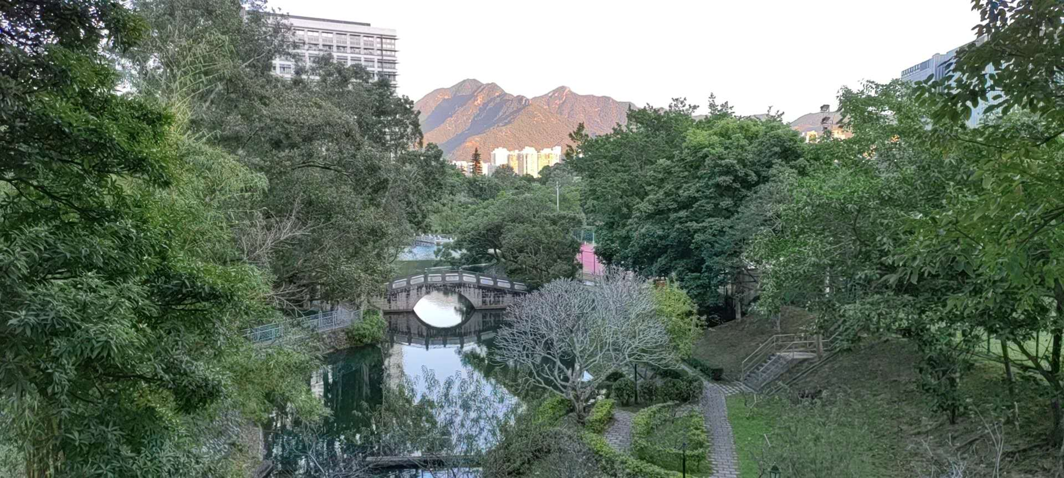
Lecture 3: Network Quantization
Feng-Lei Fan (FAN: Frontier of Artificial Networks)
Assistant Professor, City University of Hong Kong

Slide 2
Acknowledgement
These slides contain materials developed by
Song Han: https://www.dropbox.com/scl/fi/eos92o2fgys6gk0gizogl/lec05.pdf?rlkey=2hohvi8jcvjw3f8m8vugfa2mz&e=1&dl=0
Outline

Slide 3
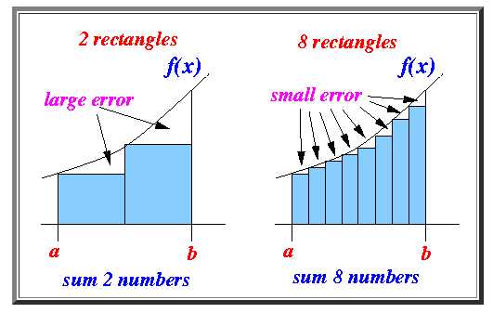
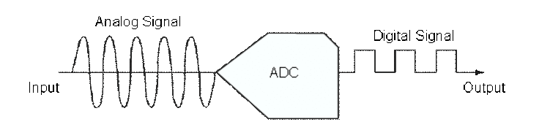
What is Quantization
Calculus
Analog2Digital Conversion

Slide 4
Outline
Data Type
Neural Network Quantization
Common Quantization Methods
Outline

Slide 5
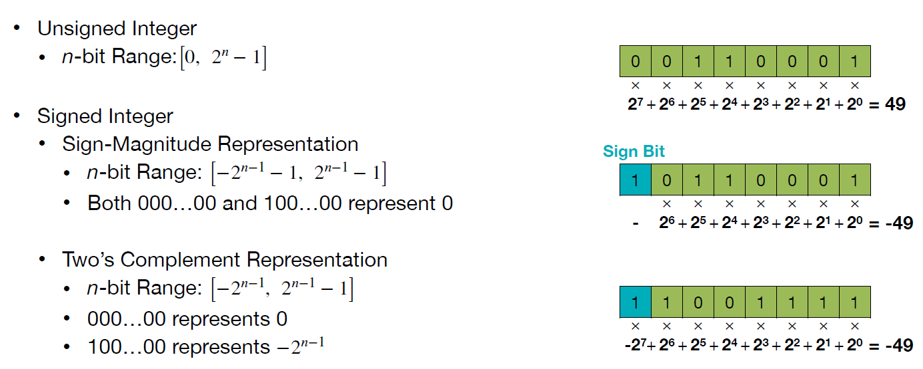
Integer
Outline

Slide 6
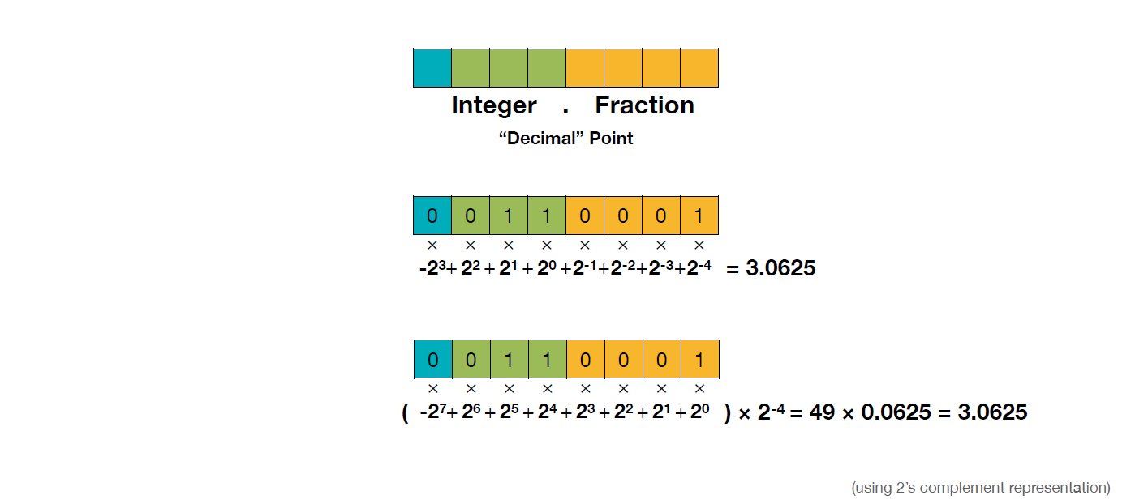
Fixed-Point Number
Outline

Slide 7
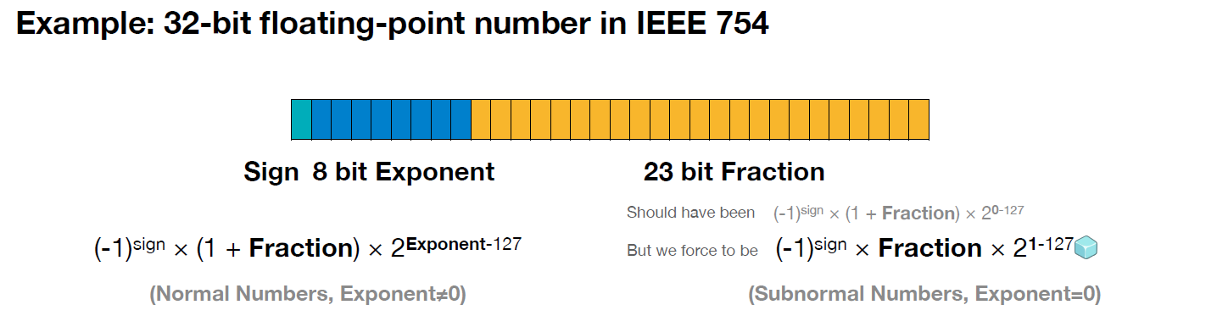
Floating-Point Number

Slide 8
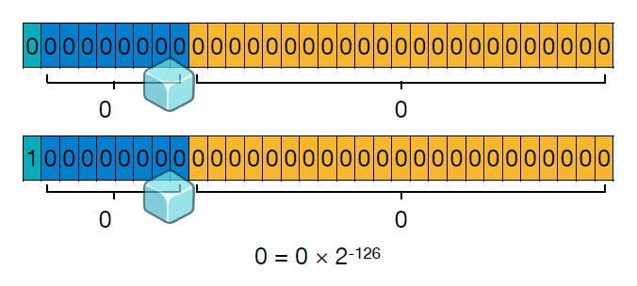
Floating-Point Number
How should we represent 0?

Slide 9
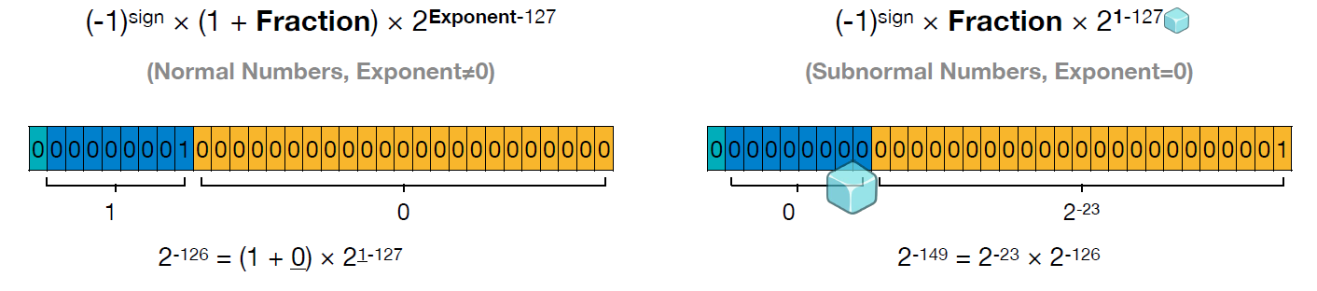
Floating-Point Number
What is the minimum positive number?

Slide 10
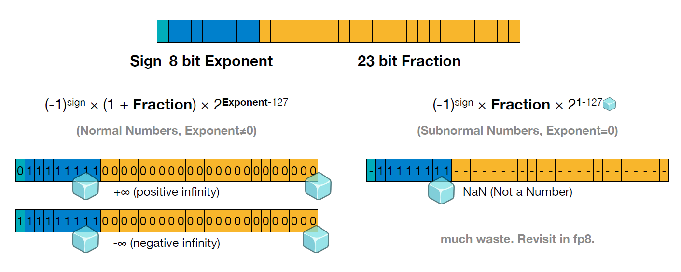
Floating-Point Number
What is the maximum positive number?

Slide 11
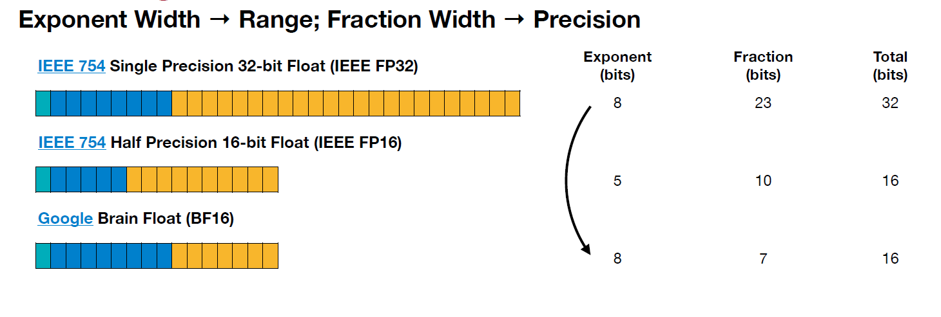
Floating-Point Number

Slide 12
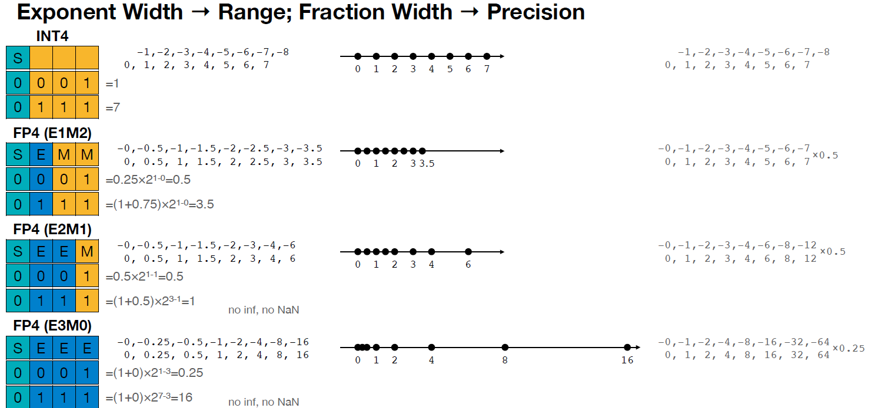
INT4 and FP4

Slide 13
Outline
Data Type
Neural Network Quantization
Common Quantization Methods
Outline

Slide 14
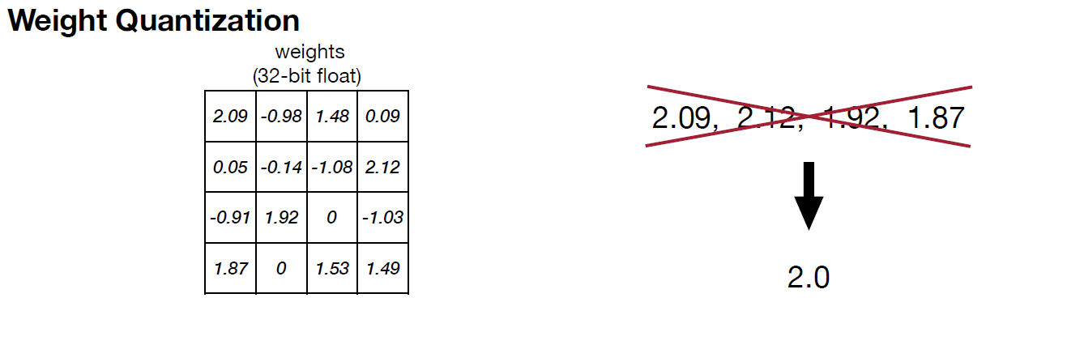
Quantization

Slide 15
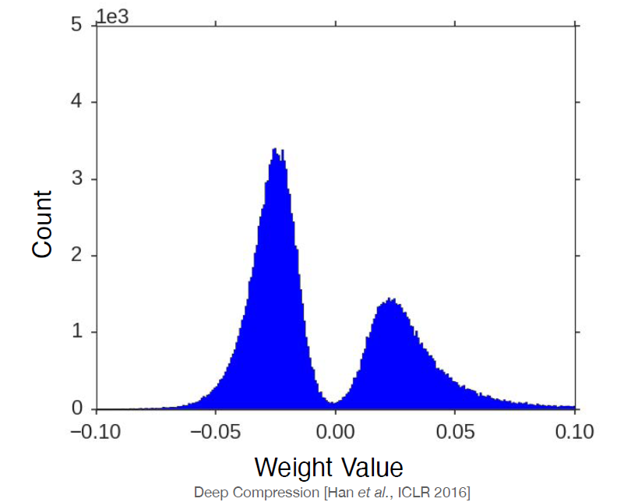
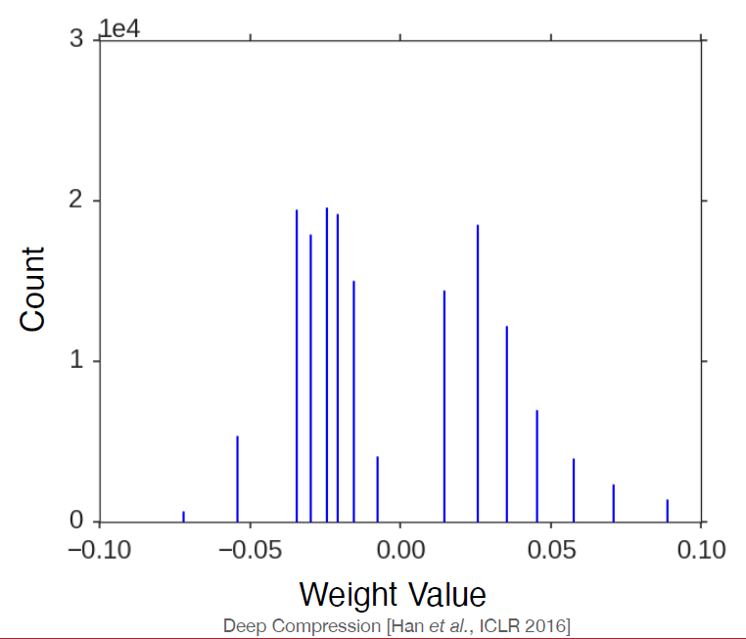
Quantization
Before
After

Slide 16
Outline
Data Type
Neural Network Quantization
Common Quantization Methods
Outline

Slide 17
Common Methods
K-Means-based
Linear Quantization

Slide 18
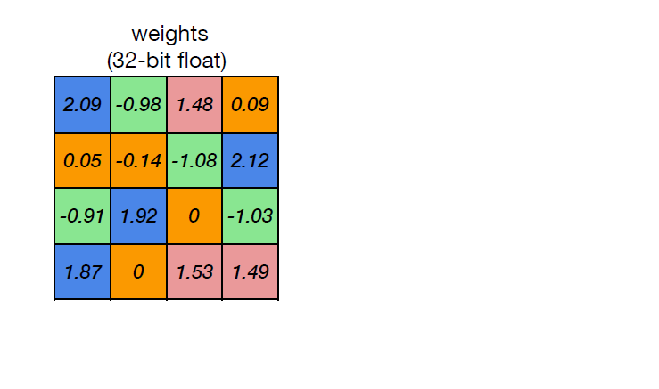
K-Means-based Quantization

Slide 19
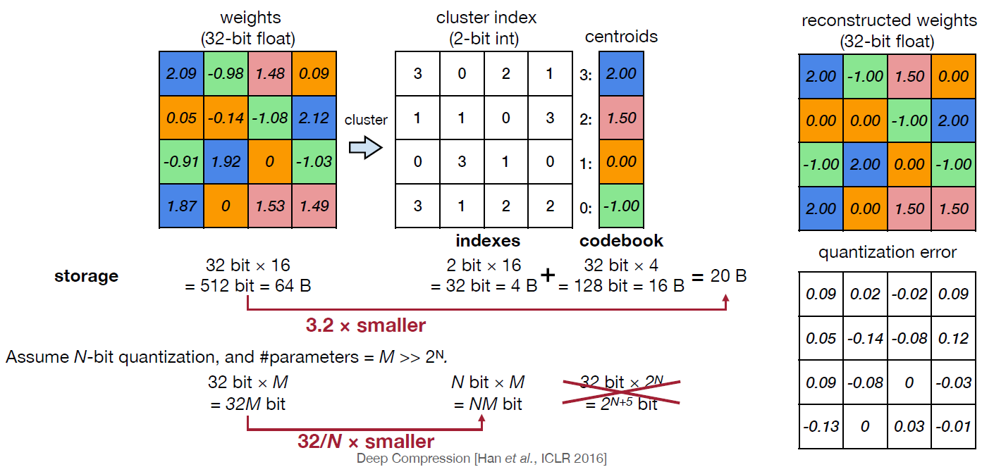
K-Means-based Quantization

Slide 20
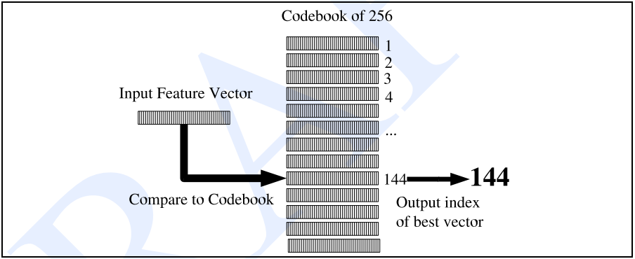
Vector Quantization
Establishing a Vector Codebook

Slide 21
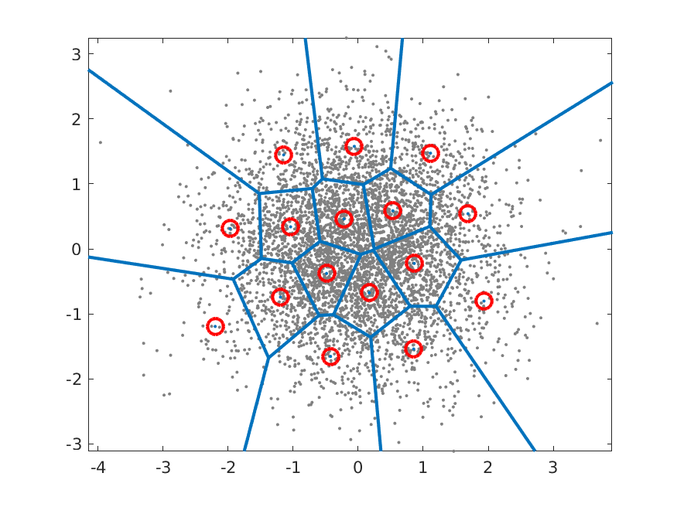
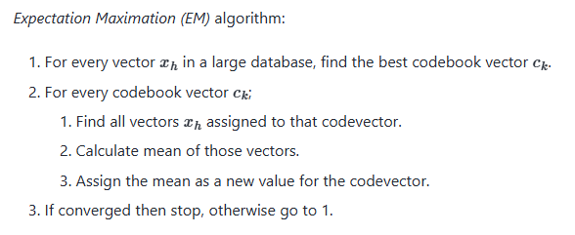
Vector Quantization
Algorithm

Slide 22



Linear Quantization
$$r_{min}$$
$$r_{max}$$
0
$$q_{max}$$

Slide 23
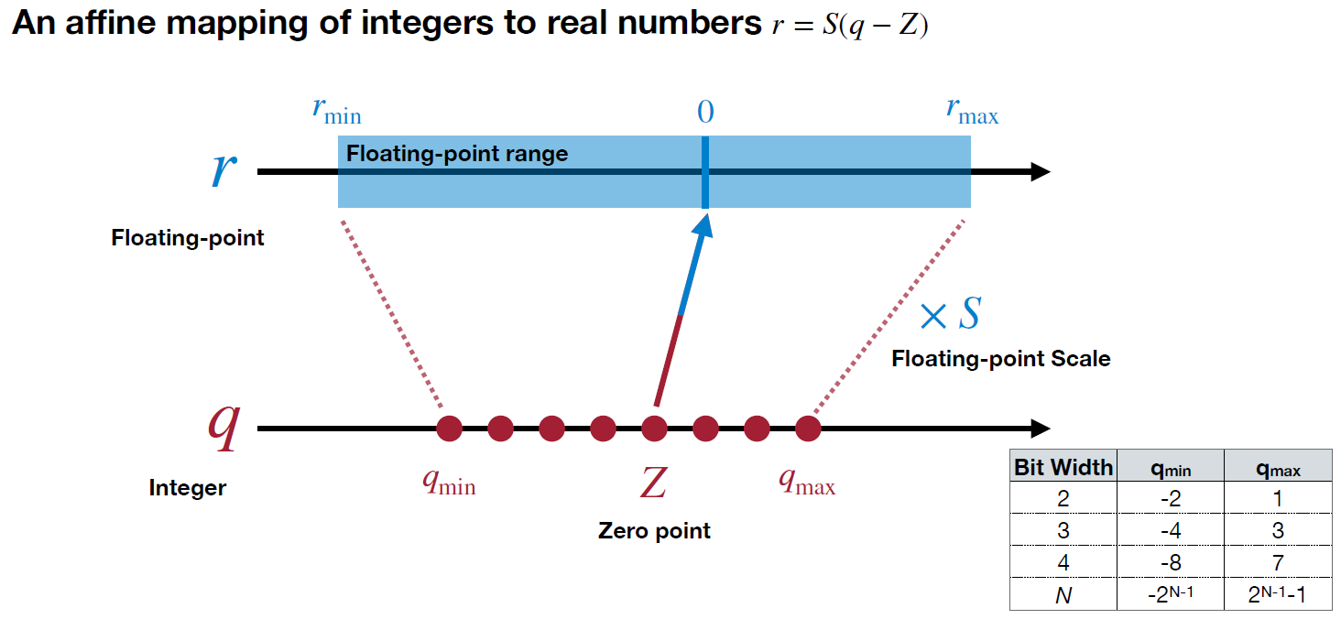
Linear Quantization

Slide 24
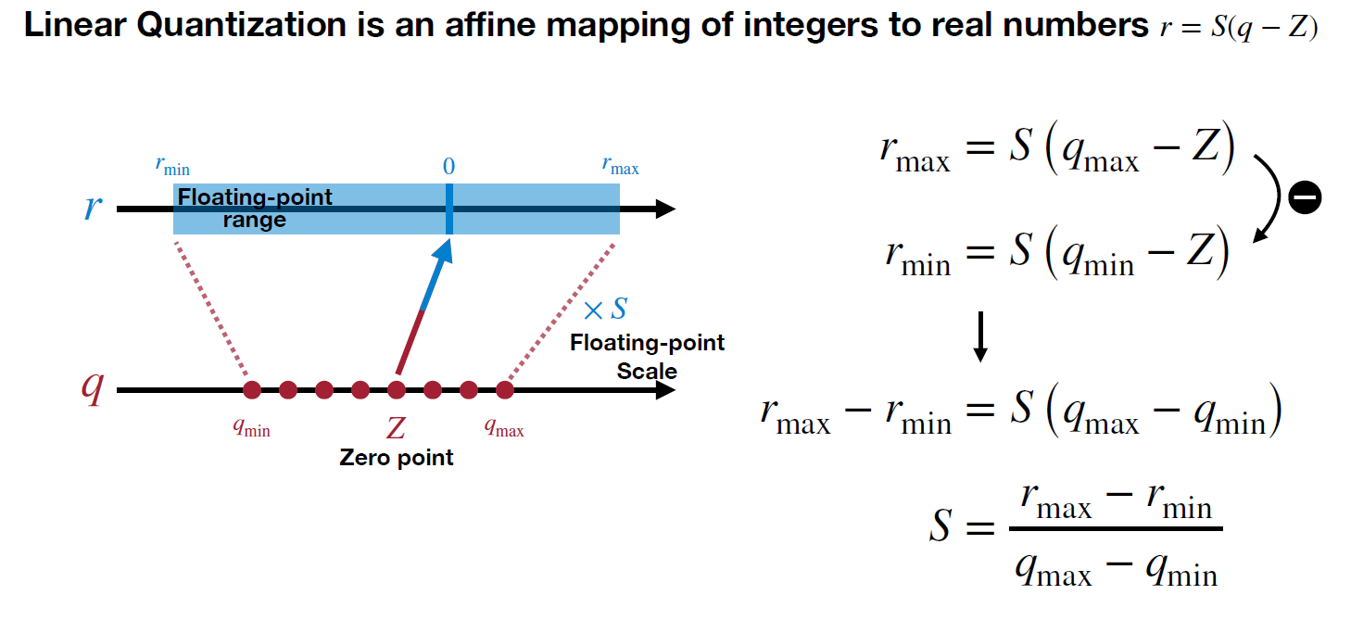
Linear Quantization

Slide 25
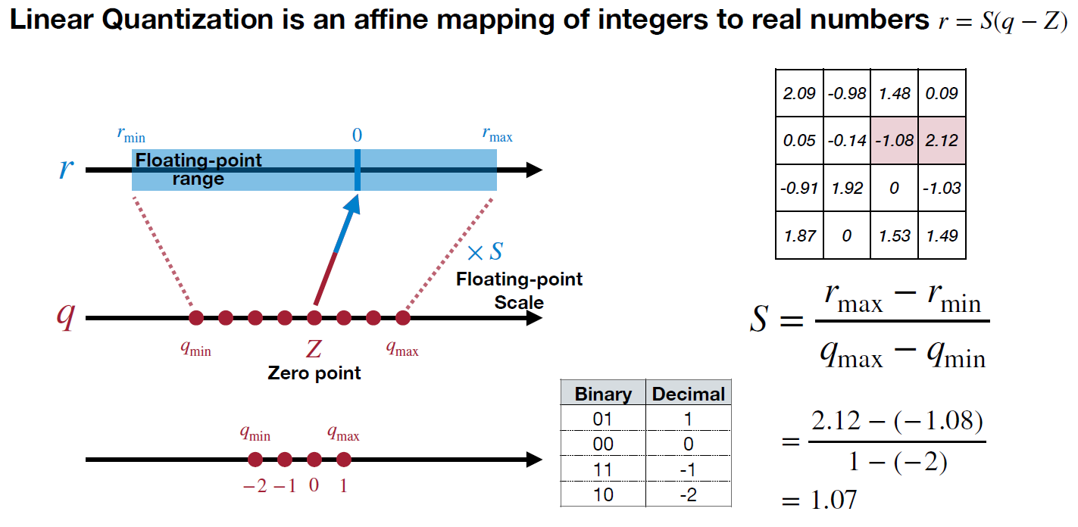
Linear Quantization

Slide 26
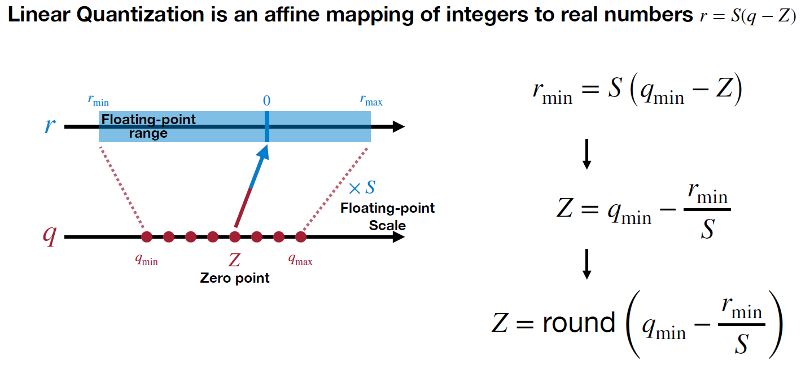
Linear Quantization

Slide 27
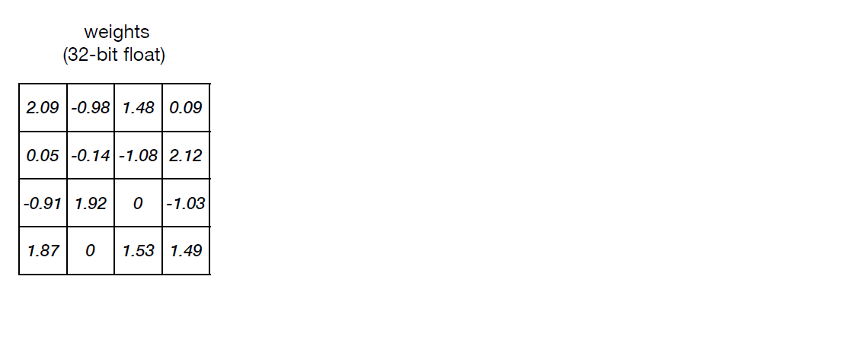
Linear Quantization

Slide 28
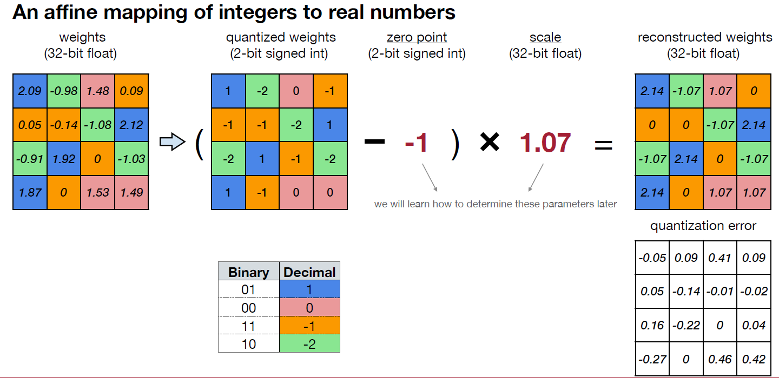
Linear Quantization

Slide 29
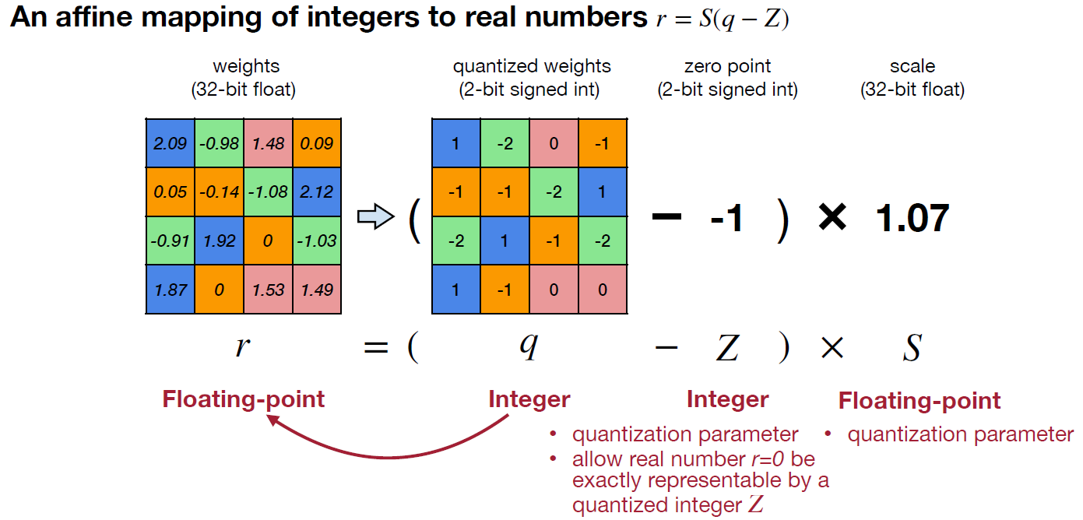
Linear Quantization

Slide 30
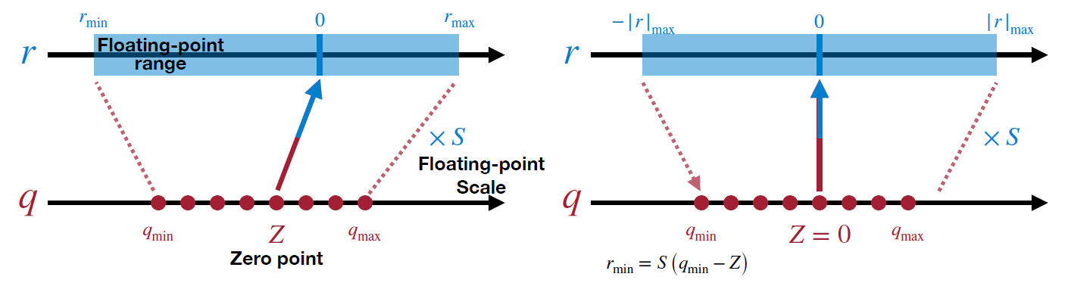
Symmetric Linear Quantization

Slide 31
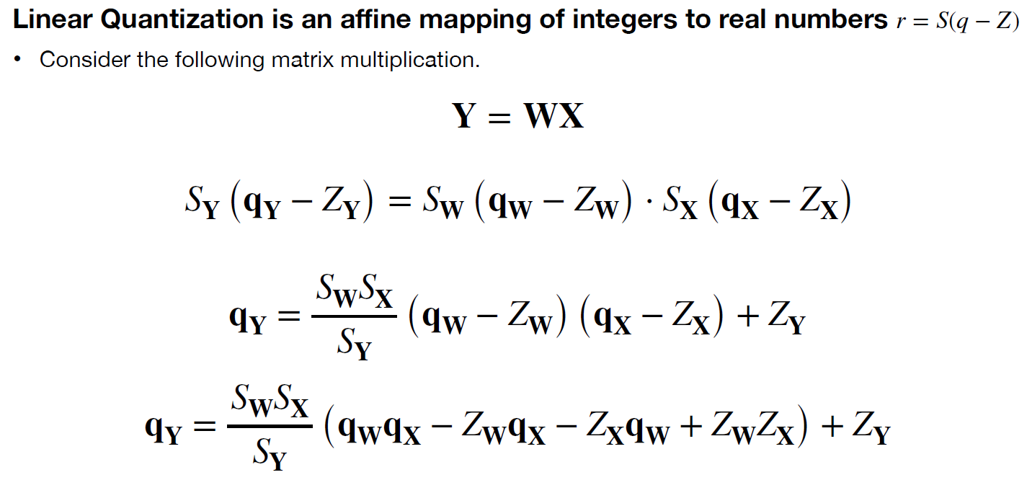
Matrix Form

Slide 32
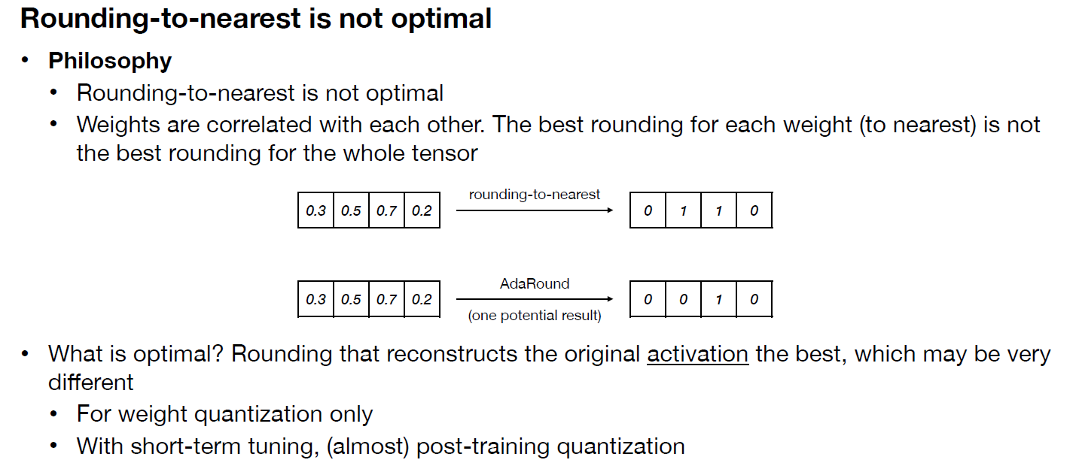
Rounding

Slide 33
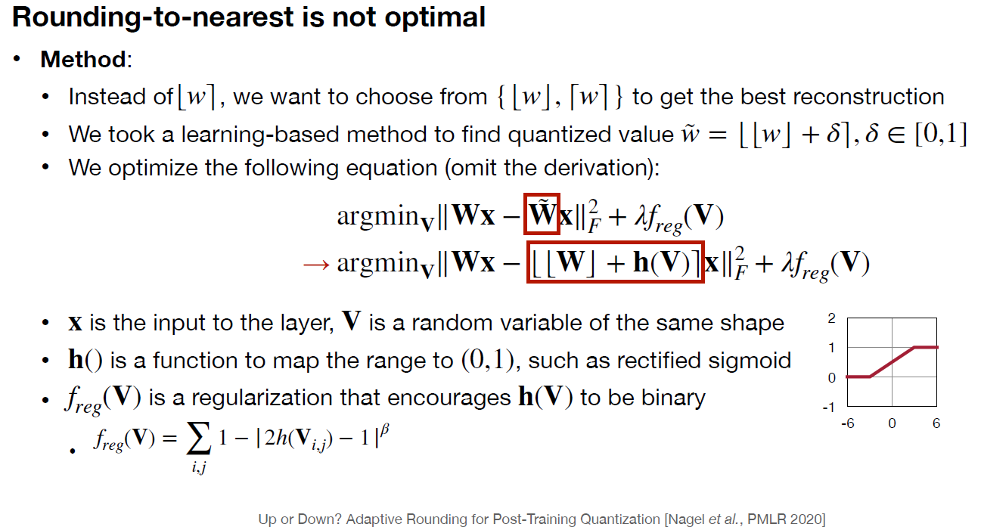
Rounding

Slide 34
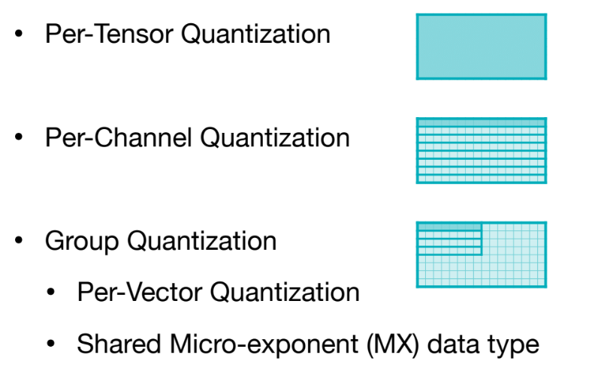
Granularity

Slide 35
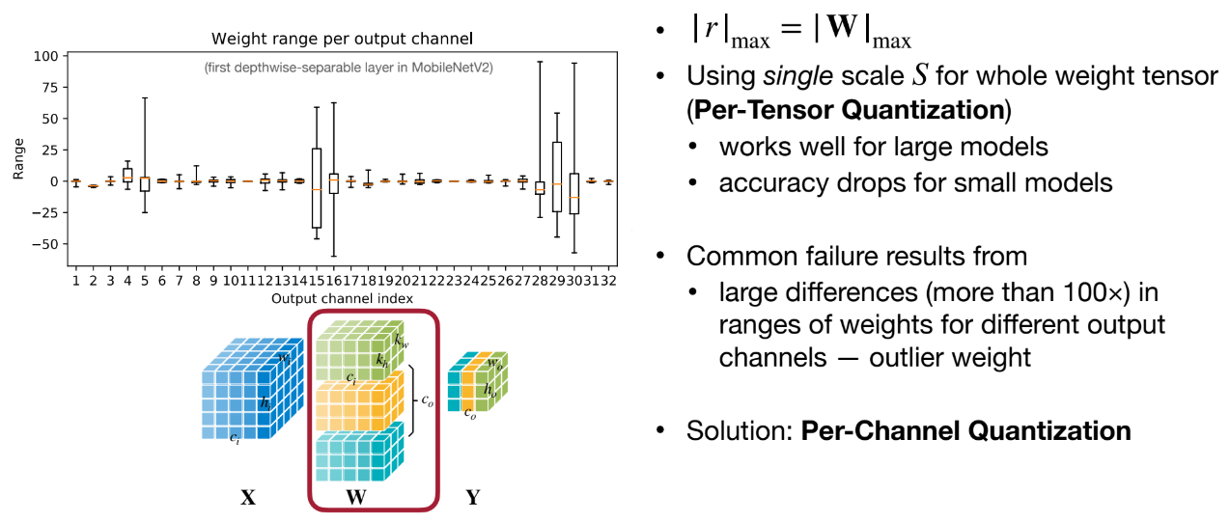
Granularity

Slide 36
Importance Score
Same as pruning!

Slide 37
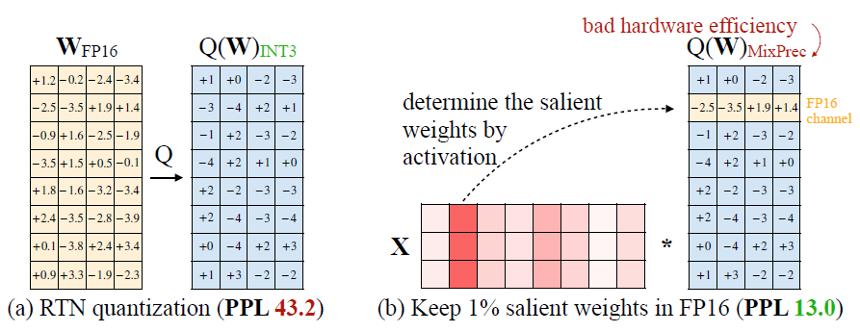
Mixed Precision
Activation magnitude
Lin, J., Tang, J., Tang, H., Yang, S., Chen, W. M., Wang, W. C., ... & Han, S. (2024). Awq: Activation-aware weight quantization for on-device llm compression and acceleration. Proceedings of machine learning and systems, 6, 87-100.

Slide 38
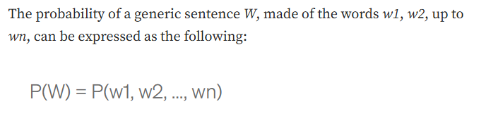
Perplexity
capture the degree of ‘uncertainty’ a model has in predicting (i.e. assigning probabilities to) text

Slide 39


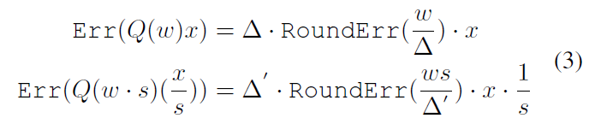
Mixed Precision
Lin, J., Tang, J., Tang, H., Yang, S., Chen, W. M., Wang, W. C., ... & Han, S. (2024). Awq: Activation-aware weight quantization for on-device llm compression and acceleration. Proceedings of machine learning and systems, 6, 87-100.

